Slide 1
Transmission
Lines

Slide 2
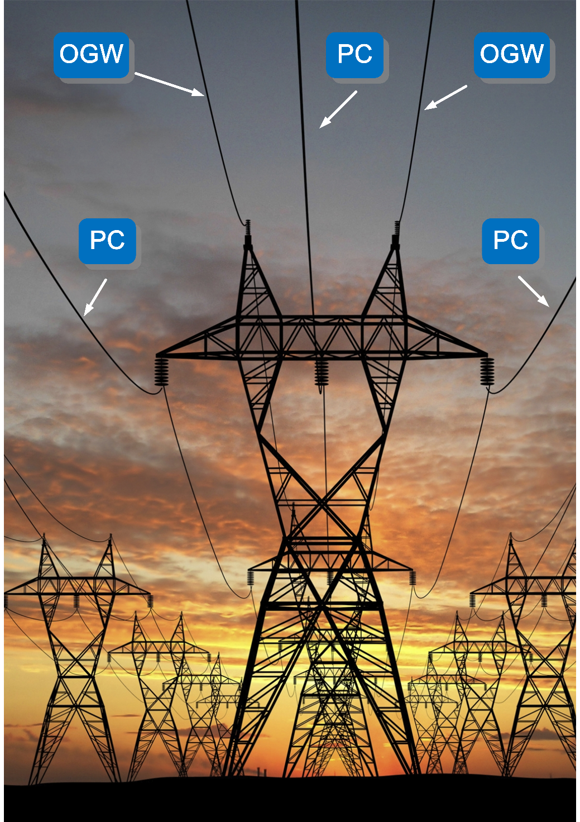
Power transmission lines, each having three phase conductors (labeled PC), suspended on metallic towers using insulators, and two overhead ground wires (labeled OGW), installed above phase conductors for lightning protection. Courtesy of Mannvit Engineering.

Slide 3
Transmission Lines
A.c. source
Cross-sectional view of typical transmission lines (a) coaxial line, (b) two-wire line, (c) planar line, (d) wire above conducting plane, (e) microstrip line.
(a) Coaxial line connecting the generator to the load; (b) E and H fields on the coaxial line (TEM field structure).

Slide 4
Transmission Lines
Electric and magnetic fields
around a two-wire
transmission line (Transverse
ElectroMagnetic (TEM) field
structure)
Triplate line
Stray field
Microstrip
lines

Slide 5
Transmission Line (Telegrapher’s) Equations for a Lossless Line
Transmission Lines
The transmission line consists of two parallel and uniform conductors, not necessarily identical.
Where L and C are the inductance and capacitance per unit length of the line, respectively.
Notes:
Intuitively.. Why do we have to include Inductors and Capitors?
Where did the Resistances and Conductance vanish?

Slide 6
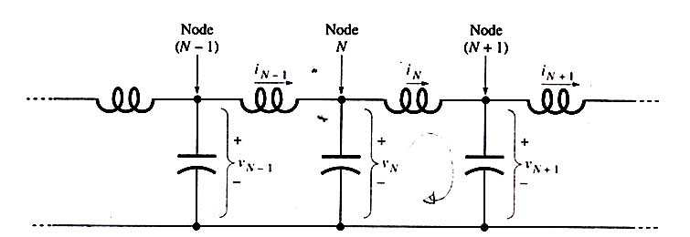
Transmission Lines
i_{NS}
N’
(N+1)’
Definitions of currents and voltages for the lumped-circuit transmission-line model.
By applying Kirchhoff’s voltage law to N - (N + 1) - (N + 1)’ - N’ loop, we obtain
If node N is at the position z, node (N +1) is at position z + h, and

Slide 7
Transmission Lines
Since h is an arbitrary small distance, we can let h approach zero
1st TL equation
Applying Kirchhoff’s current law to node N we get
from which
2nd TL equation

Slide 8
All cross-sectional information about the particular line is contained in L and C
Transmission Lines
Telegrapher’s
Equations
(TL Eqns.)
Wave Equation

Slide 9
Transmission Lines
Waves on the Lossless Transmission Line (solution of the wave equation)
Roughly speaking, a wave is a disturbance that moves away from its source as time passes. Suppose that the voltage on a transmission line as a function of position z and time t has the form
V(z,t) = f(z-Ut), where U = const = (LC)^{-1/2}
This is the same function as f(z), but shifted to the right a distance of Ut along the z axis. The displacement increases as time increases. The velocity of motion is U.
x = z-Ut
f(x) has its maximum where x = z – Ut = 0, so
at t = 0 the position of maximum Zmax = 0 and
at at t = t_{o} it is given by Zmax = Ut_{o}
t = 0
Any function of the argument (z-Ut) keeps its shape and moves as a unit in the +z direction. For example, let f(x) be the triangular function shown in (a). Then at time t=0 f(z-Ut)=f(z) is the function of z shown in (b). At a later time t_{o} , f(z-Ut)=f(z-Ut_{o}) is the function of z shown in (c). Note that the pulse is moving to the right with velocity U.
t = t₀
→U

Slide 10
Transmission Lines
The function V(z,t) = f(z-Ut) describes undistorted propogation in the +z direction and represents a solution of the wave equation for a lossless transmission line, which can be verified by substitution:
Wave Equation
V(z,t) = f(z-Ut)
Second-order derivative of f with respect to (z-Ut)
(f’’(z – Ut) ≠ 0)
The wave equation is satisfied provided that
The leftward-traveling wave v(z,t) = f(z+Ut) is also a solution.
U is the phase velocity (m/s).

Slide 11
Let f(x)=Acoskx. If x=z-Ut, v(z,t)=Acos[k(z-Ut)] = Acos(kz-ωt) (kU=ω=2πf, U= ω/k)
Transmission Lines
t = 0
An important special case is that in which the function f is a sinusoid. Fig (a) shows the function v(z,t)=Acos(kz-ωt) as it appears if photographed with a flash camera at time t=0. In (b) it is seen at the later time to
v(z,t)=Acos[k(z-Ut)]= Acos(kz-ωt)
t = t_{o}
- angular frequency, rad/s
U – phase velocity, m/s
k – propagation constant,
rad/m
The wavelength of the wave is defined as the distance between the maxima at any fixed instant of time. V(z,t) has maxima when its argument (kz-ωt) is zero,
±2π, ±4π, etc. At t = 0, there is a maximum at z₁ = 0. The next one occurs when kz = 2π , or z₂ = 2π / k.
λ = z₂ – z₁ = 2π / k
U = ω/k = 2πf / k = λf

Slide 12
Transmission Lines
The separation of time and space dependence for sinusoidal (time–harmonic) waves is achieved by the use of phasors.
Phasors are the complex quantities (in polar form) representing the magnitude and the phase of sinusoidal functions. Phasors are independent of time.
Time-harmonic function expressed as a cosine wave
Time Factor
“The real part of”
Phasor
For a wave
moving in the +z direction,
The phasor representing this positive–going wave is
For a wave
moving to the left,

Slide 13
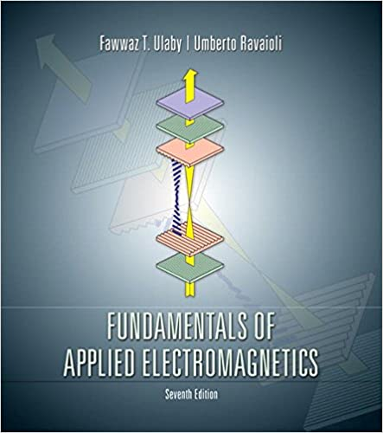
Book Website: www.pearsonhighered.com/ulaby

Slide 14
Let f(x)=Acoskx. If x=z-Ut, v(z,t)=Acos[k(z-Ut)] = Acos(kz-ωt) (kU=ω=2πf, U= ω/k)
Transmission Lines
v(z,t) = Acos(kz-ωt)
= Acos (ωt-kz)
t = 0
An important special case is that in which the function f is a sinusoid. Fig (a) shows the function v(z,t)=Acos(kz-ωt) as it appears if photographed with a flash camera at time t=0. In (b) it is seen at the later time to
v(z,t) = Acos(ωt-kz)
$$U$$
t = t_{o}
- angular frequency, rad/s
U – phase velocity, m/s
k – propagation constant,
rad/m
The wavelength of the wave is defined as the distance between the maxima at any fixed instant of time. V(z,t) has maxima when its argument (kz-ωt) is zero,
±2π, ±4π, etc. At t = 0, there is a maximum at z₁ = 0. The next one occurs when kz = 2π , or z₂ = 2π / k.
λ = z₂ – z₁ = 2π/k
U = ω/k = 2πf/k = λf

Slide 15
Transmission Lines
Positions of voltage phasor in the complex-number plane for 3 values of z: z₀ (reference), (z₀+Δz), and (z₀+2Δz).
A=const at all z values, since we are dealing with a lossless line; only the phase (kz) varies with z.
For the leftward–moving wave, the phasor would rotate in the counter–clockwise direction in the complex-number plane.
Rightward- moving wave
Aexp(-jkz₀) = A
1st TL equation in phasor form (∂/∂t → jω)
L $∂$i(z,t)/$∂$t = - $∂$v(z,t)/$∂$z
$$Ljω\underline{i}(z)=−\frac{d}{dz}\underline{v}(z)$$

Slide 16
Transmission Lines
Characteristic Impedance
The positive-going voltage wave with a non-zero initial phase ϕ:
(A=const, $ϕ$=const)
Instantaneous voltage
Voltage phasor
The first telegrapher’s equation in phasor form:
$$Ljω\underline{i}(z)=−d\underline{v}(z)/dz$$
For the positive–going wave,
Characteristic impedance
(independent of position)
Since
and
- real number (50-400 Ω)
$$\frac{{\underline{v}}^{−}(z)}{{\underline{i}}^{−}(z)}=−Z_{o}$$
For a negative–going wave ,

Slide 17
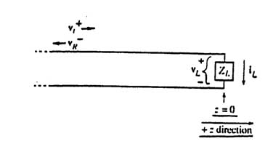
Transmission Lines
Reflection and Transmission
At z = 0,
Z₀
$$\frac{{\underline{v}}_{r}^{−}(z=0)}{{\underline{v}}_{i}^{+}(z=0)}=ρ_{o}$$
Assuming that the incident wave
is known and solving for
, we obtain
$$\frac{{\underline{v}}_{r}^{−}(z=0)}{{\underline{v}}_{i}^{+}(z=0)}=\frac{Z_{L}−Z_{o}}{Z_{L}+Z_{o}}=ρ_{o}$$
Load’s Reflection
Coefficient

Slide 18
Transmission Lines
Reflection and Transmission (continued)
Example
Suppose Z_{L} = ∞ (open circuit). Find the distribution of the voltage on the line if the incident wave is
Assume that A is real (ϕ = 0)
The total voltage on the line is:
$\underline{v}(z)=Ae^{−jkz}+Ae^{jkz}$ $=2A\cos{k}z$
at
The instantaneous voltage is:
At
at all times.
The total voltage is the sum of the two waves of equal amplitude moving
in opposite directions. The positions of zero total voltage stand still. This phenomenon is referred to as a standing wave.
In the case of a single traveling wave,
, there are
positions where the voltage vanishes, but these positions do not stand still; they move at the phase velocity of the wave

Slide 19
Transmission Lines
Reflection and Transmission (continued)
If
(short circuit),
and
Again we have a standing wave but with the nulls at
If
(resistive),
When n=1 (
), i.e. TL is terminated in its characteristic impedance),
the reflected wave vanishes

Slide 20
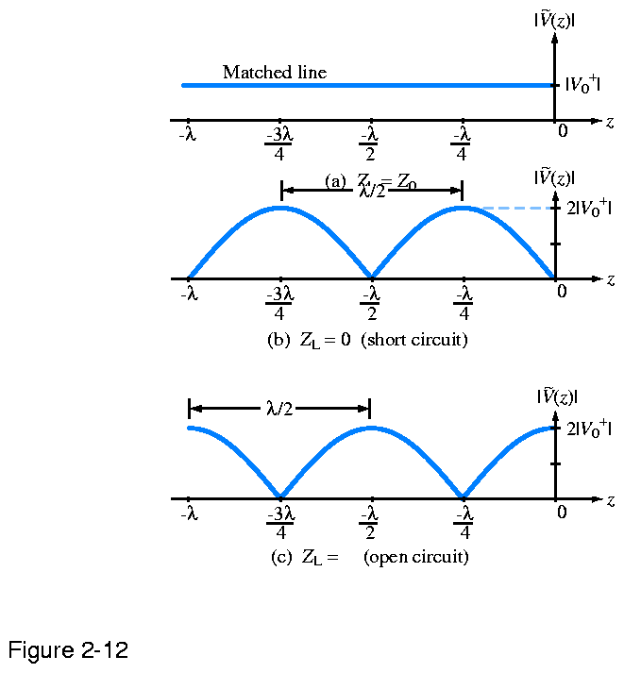
Magnitude of the total voltage phasor
Z_{L} = Z₀
Voltage is the same at any z
$ρ_{o}$= 0
Voltage vanishes at z=0
$ρ_{o}$= -1
Voltage doubles at z=0
$ρ_{o}$= 1
∞

Slide 21
Transmission Lines
Reflection and Transmission
At z = 0,
Z₀
Assuming that the incident wave
is known and solving for
, we obtain
Load’s Reflection
Coefficient

Slide 22
Magnitude of the total voltage phasor
Z_{L} = Z₀
Voltage is the same at any z
$ρ_{o}$= 0
Voltage vanishes at z=0
$ρ_{o}$= -1
Voltage doubles at z=0
$ρ_{o}$= 1
∞

Slide 23
Transmission Lines
Reflection and Transmission (continued)
Suppose that one more transmission line is connected at the load terminals (z=0)
Z₀₁
Z₀₂
$$\frac{{\underline{v}}_{r}^{−}(z=0)}{{\underline{v}}_{i}^{+}(z=0)}=ρ_{o}$$
$$\frac{{\underline{v}}_{t}^{−}(z=0)}{{\underline{v}}_{i}^{+}(z=0)}={τ=1 −ρ_{o}}_{}$$

Slide 24
Transmission Lines
Reflection and Transmission (continued)
The voltage at z=0, if we approach from the left, is
. If we
. Thus we can write:
approach from the right, it is
Applying Kirchhoff’s current law we get
Further,
The currents
,
,
and
can be expressed in term of
,
, and
,respectively:
Now, assuming that
is known, we can find
and
Z_{L} and Z₀₂ connected in parallel
(Reflection Coefficient)
(Transmission Coefficient)

Slide 25
Transmission Lines
Standing-Wave Ratio (lossless TL)
The total phasor voltage as a function of position on a line connected to a load at z=0 is
The magnitude of the reflected voltage phasor is
$$ρ_{o}∗=\left|ρ_{o}\right|e^{−jφ_{R}}$$
The magnitude of total voltage phasor as a function of z
At any position z, the instantaneous voltage on the line is a sinusoidal function of time, with the amplitude given by the above expression. This amplitude periodically increases and decreases as a function of z. The positions of voltage amplitude maxima and minima are stationary (independent of time). This phenomenon is referred to as a standing wave.

Slide 26
Transmission Lines
Standing-Wave Ratio (continued)
(losseless transmission line)
an integer
The standing-wave ratio (SWR) is defined as
SWR = 1 when
For two adjacent maxima at, say, N=1 and N=0 we can write
Voltage maxima and minima repeat every half wavelength.

Slide 27
Transmission Lines
Standing-Wave Ratio (continued)
(losseless transmission line)
In the special case of , the reflected wave vanishes and there is only a single traveling wave moving to the right. In this case the voltage amplitude is independent of position (“flat” voltage profile).
If there are two (or more) traveling waves on the line, they will interact to produce the so-called standing wave.
Voltage →
← Current (1 V/50 Ohm = 20 mA)
SWR = ?

Slide 28
Transmission Lines
Lossless TL:
R = 0
G = 0
i_{NS}
N’
(N+1)’
Definitions of currents and voltages for the lumped-circuit transmission-line model.
By applying Kirchhoff’s voltage law to N - (N + 1) - (N + 1)’ - N’ loop, we obtain
If node N is at the position z, node (N +1) is at position z + h, and

Slide 29
Transmission Lines
Since h is an arbitrary small distance, we can let h approach zero
1st TL equation
$$jωL\underline{i}(z)=−\frac{d}{dz}\underline{v}(z)$$
Applying Kirchhoff’s current law to node N we get
$$jωC\underline{v}(z)=−\frac{d}{dz}\underline{i}(z)$$
2nd TL equation
$jωL (R+ jωL$)
$jωC (G+ jωC$)

Slide 30
Telegrapher’s equations for lossy transmission lines:
$$(R+jωL)\underline{i}(z)=−\frac{d}{dz}\underline{v}(z)$$
$$(G+jωC)\underline{v}(z)=−\frac{d}{dz}\underline{i}(z)$$
Wave equation for voltage
γ²
Propagation constant squared for lossy TLs

Slide 31
Transmission Lines
Transmission Line Equations for a Lossy Line continued
(sinusoidal waves)
The propagation constant of a lossy transmission line is
(complex number)
where and are real numbers.
Inserting R=0, G=0 (lossless line) we obtain
For the positive-going wave
Causes negative phase shift (phasor rotates clockwise as z increases)
Causes attenuation (amplitude becomes smaller exponentially as z increases)

Slide 32
Transmission Lines
Transmission Line Equations for a Lossy Line (continued)
(sinusoidal waves)
A phase shift of equal to corresponds to the wave travel distance z equal to the wavelength :
is the phase constant (measured in radians per meter, rad/m)
is the attenuation constant (measured in Nepers per meter, Np/m)
is the attenuation distance, m (amplitude decreases 1/e over z= )
The corresponding instantaneous voltage is
In general, nonlinear functions of ω
(A is assumed to be real)
The position of a maximum is given by
As t increases, the maximum moves to the right with velocity
- Phase Velocity (U)

Slide 33
Transmission Lines
Characteristic Impedance of a lossless TL
The positive-going voltage wave with a non-zero initial phase ϕ:
(A=const, $ϕ$=const)
Instantaneous voltage
Voltage phasor
The first telegrapher’s equation in phasor form:
$$Ljω\underline{i}(z)=−d\underline{v}(z)/dz$$
For the positive–going wave,
Characteristic impedance
(independent of position)
Since
and
- real number (50-400 Ω)
$$\frac{{\underline{v}}^{−}(z)}{{\underline{i}}^{−}(z)}=−Z_{o}$$
For a negative–going wave ,

Slide 34
$$\underline{v}+\left(z\right)=A+e_γz$$
γ = [($R+jωL$)($G+jωC$)]^{1/2}
$\frac{d}{dz}\underline{v}+(z)$= - γ $\underline{v}+\left(z\right)$
$$−\frac{d}{dz}\underline{v}(z) \text{=} (R+jωL)\underline{i}(z)$$
$$−\frac{d}{dz}\underline{v}+\left(z\right) \text{=} \left(R+jωL\right)\underline{i}+(z)$$
Characteristic impedance of lossy TL
$$γ\underline{v}+\left(z\right) \text{=} \left(R+jωL\right)\underline{i}+(z)$$
$\underline{v}+\left(z\right)\text{/}\underline{i}+(z) \text{=} \left(R+jωL\right)$/γ
$\text{Z}\text{0} \text{= }\left(R+jωL\right)$/γ = [($R+jωL$)/($G+jωC$)]^{1/2}

Slide 35
TRANSMISSION LINES - 7 lectures
Transmission line equations (lossless lines)
Sinusoidal waves
Characteristic impedance
Reflection and transmission; standing wave
Attenuation and dispersion (lossy lines)
Non-sinusoidal waves (bounce diagram)

Slide 36
Transmission Lines
Non-Sinusoidal Waves
(lossless transmission line)
Reflection of a rectangular voltage pulse of a short circuit (Z=0, $ρ_{o}$= -1).
(a) Shows the incident voltage pulse moving to the right.
In (b) it is striking the short-circuit termination; note that the sum of the incident and the reflected voltages must always be zero at that position.
In (c), the reflected pulse is moving to the left.
Δz
Δz

Slide 37
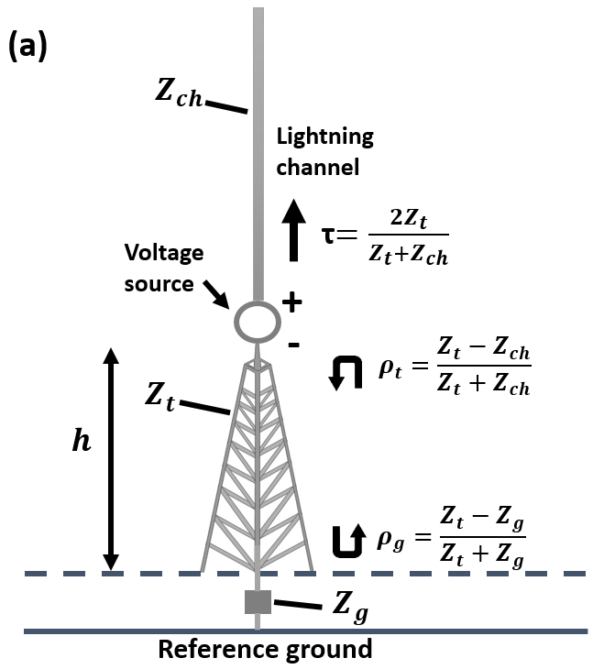
Lightning Return-Stroke Model Including a Tall Strike Object (Zhu et al., 2018)
Transmission line representations of lightning channel and 300-m tall tower
The distributions of current along the tower and along the lightning channel：
Z_{ch} = 3Z_{t}
Along the tower (v = c):
-0.5
Along the lightning channel (v = c/2):
+1
Reflection coefficients here are given for current, not for voltage (+1 for current corresponds to -1 for voltage).

Slide 38
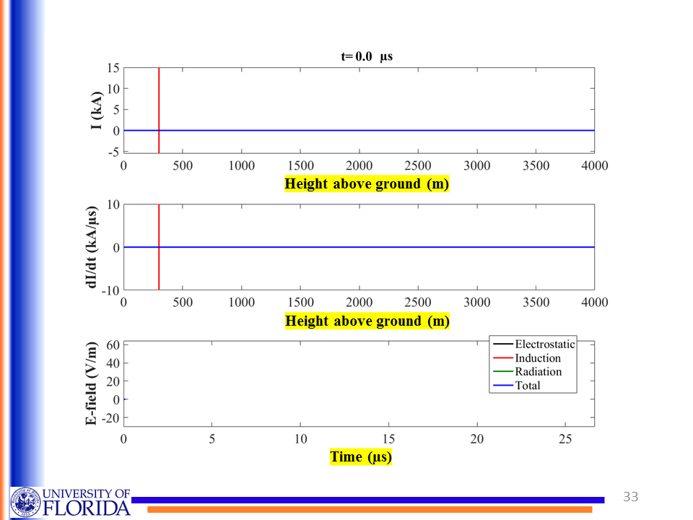
Tower
Lightning Channel
c
v=c/2
Tower bottom
Tower top
Height above ground (m)
Height above ground (m)
h = 300 m, r = 10 km
Time (µs)

Slide 39
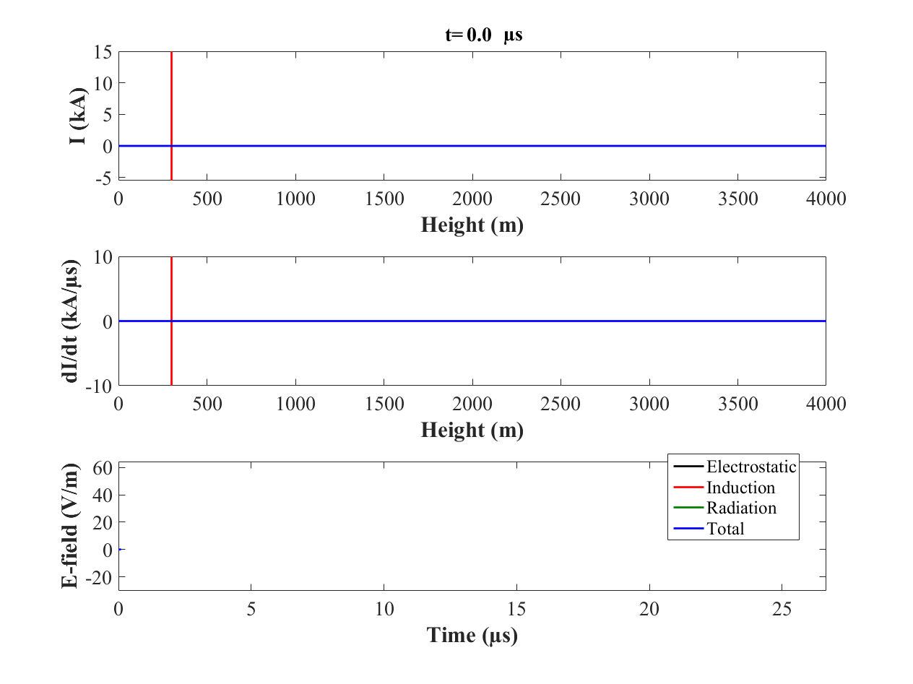
Tower bottom
Tower top
Height above ground (m)
Height above ground (m)
Time (µs)

Slide 40
Transmission Lines
Lattice (bounce) diagram
This is a space/time diagram which is used to keep track of multiple reflections.
Ideal voltage source
$ρ_{S}$=-1
z
z
$ρ_{R}$=0.5
$ρ_{R}$=-0.5
Voltage at the receiving end

Slide 41
Transmission Lines
Multiple Reflections
Voltage seen at terminals AA’
R_{s}
+z
Z₀
-z
R_{L}=R_{s}
+z
V₀
Example: Suppose that V_{s}(t) is a step function whose magnitude is V₀. Find the total voltage on the line after a very long time (at t = ∞) if
, so that
The initial (incident) wave moving to the right has amplitude
The first reflected wave moving to the left has amplitude
where
, because

Slide 42
Transmission Lines
Multiple Reflections (continued)
The second reflected wave moving to the right has amplitude
and so on
The total voltage at is given by the infinite series:
Inserting the values of and V₁ we find that V_{T} = V₀/2 (simply results from the voltage divider of R_{S} and R_{L} = R_{S} , as if the line were not there).
, because

Slide 43
READING ASSIGNMENT FOR SECTION 1 (Transmission Lines) Textbook (Ulaby and Ravaioli): In Ch. 2, Sections 2.1 - 2.4, 2.6, 2.7, 2.9, 2.12, Chapter 2 Summary (pp. 122-123) Exercises: 2-1 to 2-8, 2-10, 2-11, 2-14 to 2-15 Examples: 2-1, 2-3 to 2-7, 2-15, and 2-16 Course Packet (Lecture Slides): Transmission Lines HA1 (take-home Test 1) will be given on Sept. 21 (M) between 1 and 2 p.m.; HW1 is to be turned in via Canvas not later than Sept. 23 (W), 11:45 a.m.

Slide 44
Transmission Lines
Points to Remember
In this chapter we have surveyed several different types of waves on transmission lines. It is important that these different cases not be confused. When approaching a transmission-line problem, the student should begin by asking, “Are the waves in this problem sinusoidal, or rectangular pulses? Is the line ideal, or does it have losses?” Then the proper approach to the problem can be taken.
The ideal lossless line supports waves of any shape (sinusoidal or non-sinusoidal), and transmits them without distortion. The velocity of these waves is . The ratio of the voltage to current is , provided that only one wave is present. Sinusoidal waves are treated using phasor analysis. (A common error is that of attempting to analyze non-sinusoidal waves with phasors. Beware! This makes no sense at all.)
When the line contains series resistance and/or shunt conductance it is said to be lossy. In general, lossy lines do not exhibit undistorted propagation; hence a rectangular pulse launched on such a line will not remain rectangular, instead evolving into irregular, messy shapes. However, sinusoidal waves, because of their unique mathematical properties, do continue to be sinusoidal on lossy lines. The presence of losses changes the velocity of propagation and causes the wave to be attenuated (become smaller) as it travels.

Slide 45
Transmission Lines
Points to Remember (continued)
For lines other than the simple ideal lossless lines, the velocity of propagation usually is a function of frequency. This velocity, the speed of voltage maxima on the line, is properly called the phase velocity U_{p} = ω/β. The change of U_{p} with frequency is called dispersion.
Examples of non-sinusoidal waves are short rectangular pulses, and also infinitely long rectangular pulses, which are the same as step functions. Problems involving sudden voltage steps differ from sinusoidal problems, just as in ordinary circuits, problems involving transients differ from the sinusoidal steady state. Pulse problems are usually approached by superposition; that is, one tracks the pulses that propagate back and forth, adding up the waves to obtain the total voltage at any place and time.

Slide 46
Transmission Lines
Points to Remember (continued)
All kinds of waves are reflected at discontinuities in the line. If the line continues beyond the discontinuity, a portion of the wave is transmitted as well. The reflected and transmitted waves are described by the reflection coefficient and the transmission coefficient. For sinusoidal waves there is a simple formula giving the reflection coefficient for any load impedance Z_{L}. For non-sinusoidal waves, the same formula can be used, but only if the load impedance is purely resistive. Otherwise the reflected wave has a different shape from the incident wave, and a reflection coefficient cannot be meaningfully defined.
7. In the case of non-sinusoidal waves, it is sometimes necessary to add up the contributions of many reflected waves bouncing back and forth on the line. However, for sinusoidal steady-state problems, it is only necessary to consider two waves, one moving to the right and the other to the left.
(Lossless line)
(Bounce
diagram)

Slide 47
Transmission Lines
Points to Remember (continued)
When both incident and reflected waves are simultaneously present on a transmission line, a standing wave is said to be present. This means that a stationary pattern of voltage maxima and minima is formed. The ratio of the maximum voltage to the minimum voltage is called the standing-wave ratio (SWR). The positions of the voltage maxima are determined by the phase angle of the load’s reflection coefficient, and the spacing between each pair of adjacent maxima is λ/2 (and not λ, as one might think). Positions of maximum voltage are positions of minimum current, and vice versa.
9. The impedance Z(z) at any point on a line is defined as the ratio of the total voltage phasor to the total current phasor at the point z. If a standing wave is present, the impedance will be a periodic function of position along the line, with period λ/2. Note that this impedance is different from the “characteristic impedance” Zo, which is a constant that depends only on the construction of the line.
(Sinusoidal
Waves)
(Sinusoidal
Waves)

Slide 48
Transmission Lines
Dispersion
In general, the phase velocity U_{p} is a function of frequency; that is, a signal containing many frequencies tends to become ‘dispersed’ (some parts of the signal arrived sooner and others later.)
Up is independent of frequency for (1) lossless lines (R=0, G=0) and (2) distortionless lines (R/L=G/C) because for those lines β is a linear function of ω.
Cut-off frequency
Example of dispersion
diagram for an arbitrary system that is
characterized by
U_{p}>c
U_{p} at any frequency is equal to the slope of a line drawn from the origin to the corresponding point on the graph. For ω = radians/second Up = ∞. In general, U_{p} can be either greater or less then c.
Information in a wave travels at a different velocity known as the group velocity
is equal to the slope of the tangent to the ω-β curve at the frequency in question (for for this particular system). always remains less then c.
48
Notes:
48

